Slide 1
Privacy and Security for Brower Extensions: A Language-Based Approach
Ben Livshits
Microsoft Research
Redmond, Washington

Slide 2
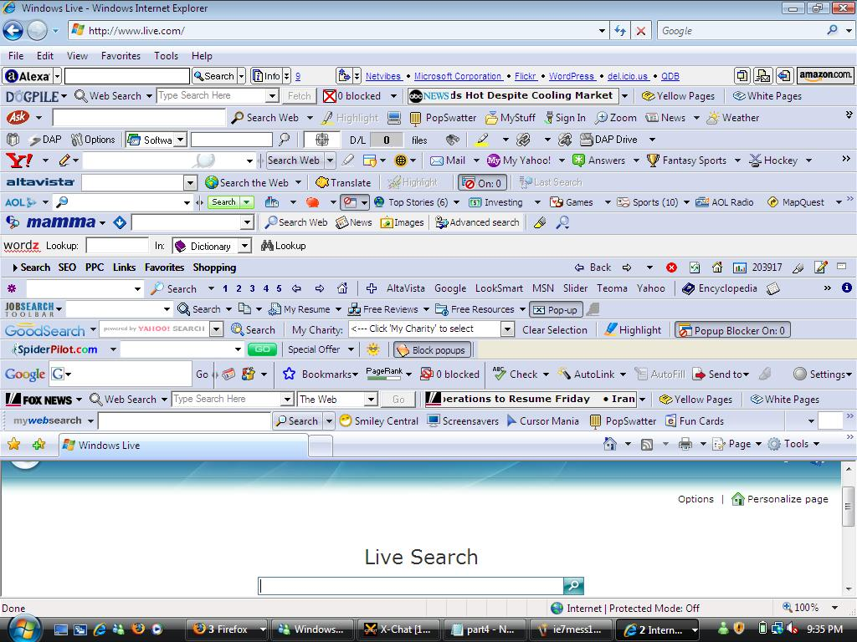
Provide missing functionality
Faster evolution that browsers
Embed themselves into browser
…which has security implications
RePriv
Verifiably
secure extensions
Language-based foundations

Slide 3
Type systems
Interest mining
Personalization
Provable privacy
RePriv
Re-envisioning in-browser privacy
Verification
Browser
Network protocols
Languages

Slide 4
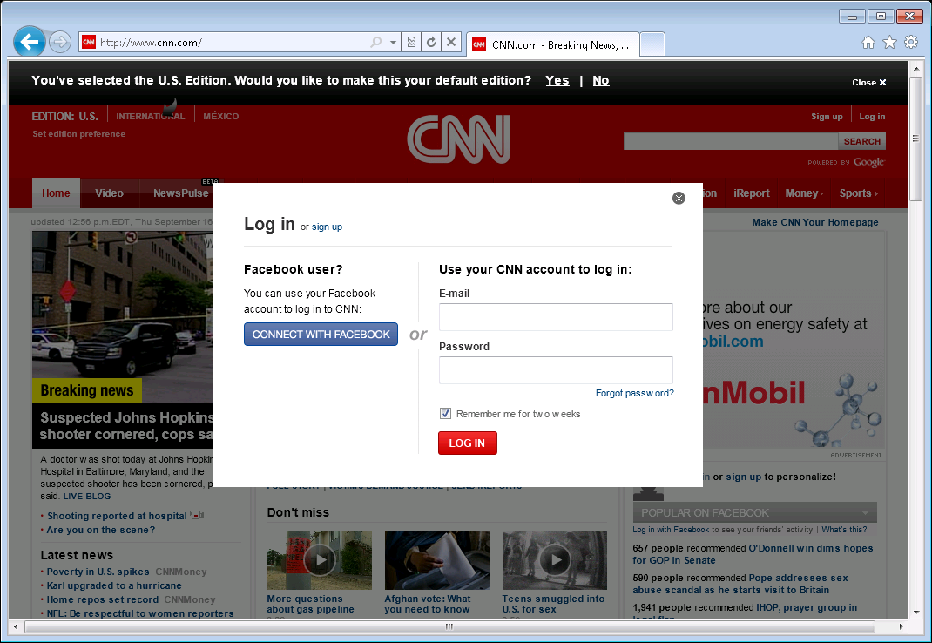
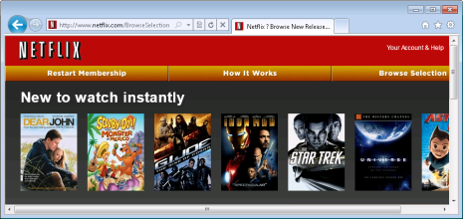
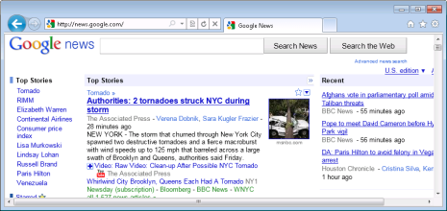
Privacy concerns
Share data to get personalized results
New York Times
Netflix
Google news
Amazon

Slide 5
Approach, Opportunity & Privacy
Broad applications:
Site personalization
Personalized search
Ads
User data in browser
Control data release
Your browser
Google
Netflix
Amazon
12
12
12
12
1
11
1
1
11
1
11
Browsing history
11
10
2
10
2
10
10
2
Top: Computers: Security: Internet: Privacy
Top: Arts: Movies: Genres: Film Noir
Top: Sports: Hockey: Ice Hockey
Top: Science: Math: Number Theory
Top: Recreation: Outdoors: Fishing
2
9
3
9
3
9
9
3
3
8
4
8
4
8
8
4
4
7
5
7
5
7
7
5
5
6
Distill
6
6
6
User interest profile

Slide 6
Scenario #1: Online Shopping
bn.com would like to learn your top interests. We will let them know you are interested in:
Science
Technology
Outdoors
Interest profile
Interest profile
Accept
Decline
Notes:
Here is a more detailed look on how we expect this story to play out.
Suppose we would like to visit a new online merchant, and still receive a personalized experience…
We have used amazon.com loyally for years, and built up a fairly detailed interest profile. This is useless on a new merchant, such as bn.com
Run through RePriv-enabled scenario of user visiting a new online merchant, and receiving a personalized experience.
Illustrates use of general interest mining.
Trust BN.com with not leaking the profile further

Slide 7
RePriv Protocol
GET /index.html HTTP 1.1
Host: www.example.com
Accept: repriv …
HTTP/1.1 300 Multiple Choices
index.html
index.html?top-n&level=m
POST /index.html HTTP 1.1
Host: www.example.com
Content-Length: x
category1=c1&…
HTTP/1.1 200 OK
Personalized page content
Notes:
Core mining is communicated to content providers with a simple protocol.
Walk through instance of protocol.
Backwards-compatible with existing HTTP implementations
Enables personalization to occur on the server-side.
Communicates topic-specific information, as well as global interest profile statistics

Slide 8
Scenario #2: Personalized Search
Would you like to install an extension called “Bing Personalizer” that will:
Watch mouse clicks on bing.com
Modify appearance of bing.com
Store personal data in browser
Personalized Results
“weather” → weather.com
“sports” → espn.com
“movies” → imdb.com
“recipes” → epicurious.com
Accept
Decline
Notes:
General behavior mining doesn’t work for all applications.
Search personalization is an example: an engine watches which queries I type, and the results I select, in order to provide personalized results.
This is too particular for a general mechanism in the browser to support.
Run through scenario of RePriv-enabled personalized search experience, to illustrate the collection/use of site-specific information.

Slide 9
Contributions of RePriv
RePriv
An in-browser framework for collecting & managing personal data to facilitate personalization.
Core Behavior Mining
Efficient in-browser behavior mining & controlled dissemination of personal data.
RePriv miners
A framework for integrating verified third-party code into the behavior mining & dissemination of RePriv.
Real-world Evaluation
Evaluation of above mechanisms on real browsing histories & two in-depth case studies.
Notes:
RePriv: a framework for protecting privacy by returning control of personal information to the client, making dissemination explicit to the user.
Core Behavior Mining: we show how a general-purpose interest profile for a user can be constructed efficiently from within the browser.
Miners: we made RePriv extensible by allowing third-party code to exist within the browser, using and contributing to the personal data maintained by RePriv. RePriv maintains privacy by rigorously verifying the behavior of all third-party code it runs.
Evaluation: we evaluated key aspects of RePriv using data collected from IE8 & Bing toolbar, as well as user studies on mechanical turk.

Slide 10
RePriv Architecture
Browser equipped with RePriv
Core mining
Core mining
Core mining
Core mining
Miners
3rd party providers
(imdb.com)
User consent and policies
RePriv APIs
Personal store
1st party providers
(netflix.com)

Slide 11
Core Mining
Taxonomy from first two levels of ODP taxonomy
~450 categories total
20 top-level categories
Overlap exists
Naïve Bayes
All categories equally likely
Training: min(3000, # pages) sites per category
Attribute words occur in at least 15% of docs for ≥1 category
Classification is fast enough: O(c•n)
n is # words in document
c is # document categories
Science
Physics
Math
Sports
Football
Top
Notes:
ODP taxonomy has been used in the web personalization literature before.
ODP provides labeled training examples in an open, publicly-available format.
Overlap isn’t a huge problem – the categories are subjectively-applied anyway.

Slide 12
Global Mining Convergence
Converges quite fast

Slide 13
RePriv vs. the White Pages
Source:
WebMii.com
# of observer samples
profile confidence

Slide 14
RePriv Miners
VERIFIED
^

Slide 15
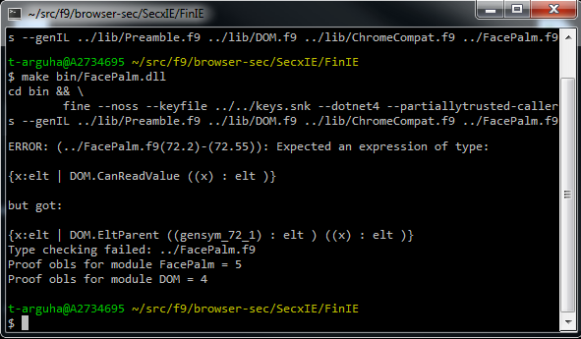
Miner Verification Strategy
Untrusted miners are written in Fine
Refined types on security-critical arguments to reflect policy needs
Policy at top of source code
Won’t compile unless code follows policy
Miner Name | C# LoC | Fine LoC | Verif. Time
TwitterMiner | 89 | 36 | 6.4
BingMiner | 78 | 35 | 6.8
NetflixMiner | 112 | 110 | 7.7
GlueMiner | 213 | 101 | 9.5
Notes:
Fine is a security-typed functional language that supports refined and affine types.
Fine programs cannot affect underlying system without API support.
Refining API parameters to match policy needs removes the need for reference monitor.
Must still verify that refinements correctly capture API functionality/associated policy implications.
NOTE: PLEASE ADD A SCREENSHOT of FINE IN ACTION

Slide 16
assume ExtensionId "twitterminer"
assume CanCommunicateXHR "twitter.com“ Nil
assume CanUpdateStore("twitter.com“ “twitterminer”)
val MakeRequest: p:provs ->
({host:string | CanCommunicate host p})
->
t:tracked<string,p> ->
…
tracked<string,fp>
val AddEntry ({p:provs | CanUpdateStore p}) ->
data:tracked<string,p> ->
string ->
tracked<list<string>,p> ->
…
unit
Web site
Personal store

Slide 17
Netflix Example
114 lines of Fine code
Update interest profile based on Netflix.com interactions
Watches clicks on rating links, updates store
Reads store to find recently-viewed movies by genre
Can provide this information on request to
fandango.com
amazon.com
metacritic.com
let doGetMovies genre cdom =
…
let flixEnts = GetStoreEntriesByTopic
myprov "movie" in
let genreFlix = bind myprov flixEnts
(filterByGenre genre) in
ExtensionReturn cdom myprov genreFlix
assume ExtensionId "netflixminer"
assume forall (s:string) . (ExtensionId s) => CanUpdateStore (P "netflix.com" s)
assume forall (s:string) . CanReadDOMId "netflix.com" s
assume CanReadDOMClass "netflix.com" "rv1"
assume CanReadDOMClass "netflix.com" "rv2"
assume CanReadDOMClass "netflix.com" "rv3"
assume CanReadDOMClass "netflix.com" "rv4"
assume CanReadDOMClass "netflix.com" "rv5"
assume CanCaptureEvents "onclick" (P "netflix.com" "netflixminer")
assume CanServeInformation "fandango.com" (P "netflix.com" "netflixminer")
assume CanServeInformation "amazon.com" (P "netflix.com" "netflixminer")
assume CanServeInformation "metacritic.com" (P "netflix.com" "netflixminer")
assume CanHandleSites "netflix.com"
assume CanReadStore (P "netflix.com" "netflixminer")
assume CanReadLocalFile "moviegenres.txt"

Slide 18
Experimental Evaluation
REAL-WORLD
^

Slide 19
Privacy-Aware News Personalization
Map RePriv intereststo del.icio.us topics
Query personal store for top interests
Ask del.icio.us API for “hot” stories in appropriate topic areas from nytimes.com
Replace nytimes.com front page with del.icio.us stories
Notes:
Our algorithm is an approximation of a collaborative recommendation system
It relies on del.icio.us

Slide 20
Privacy Policy
Query del.icio.us with top interest data
Change “href” attribute of anchor elements on nytimes.com
Change TextContent of selected anchor and div elements on nytimes.com

Slide 21
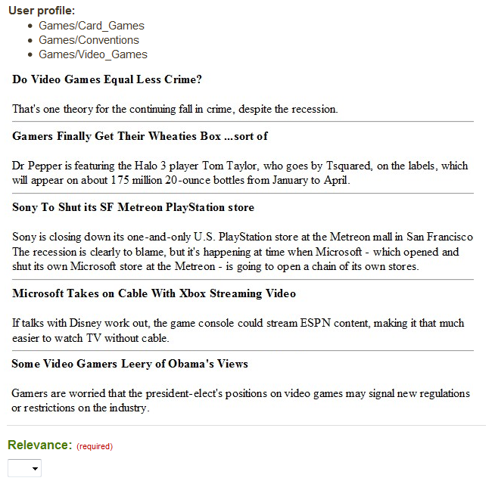
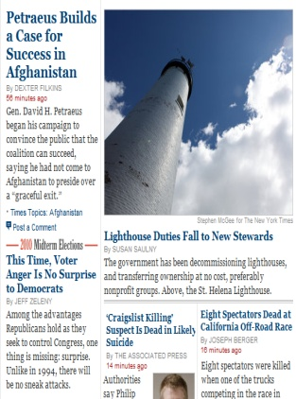
Evaluation Process
Technology/Web 2.0
Technology/Mobile
Science/Chemistry
Science/Physics
2,200 questions
Over 3 days
Types of results
Default
Personalized
Random
Notes:
Ask the audience: which new york times front page is more likely to interest the author of these slides?
The front page on the right was generated by our personalization extension.
Personalized content, such as that on the right, is becoming more popular on the web.

Slide 22
News Personalization: Effectiveness
Personalized
Most responders rated highly!
Random
Most responders rated poorly
Default
User Relevance Score
Notes:
Show results from Mturk study – violin plot.

Slide 23
Fine
JavaScript
ML
Verified Security
for Browser Extensions
Type systems
Verification and analysis

Slide 24
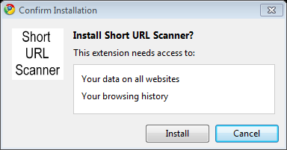
"update_url":"http://clients2.google.com/service/...",
"name": "Twitter Extender", "version": "2.0.3",
"description": "Adds new Features on Twitter.com ",
"page_action": { ... }, "icons": { ... }, \\
"content_scripts": [ {
"matches": [
"http://twitter.com/*", "https://twitter.com/*"],
"js": ["jquery-1.4.2.min.js","code.js"]
} ],
"background_page": "background.html",
"permissions": [ "tabs", "http://api.bit.ly/" ]
1,139 popular Chrome extensions
Permission | # | %
all https | 143 | 12%
all http | 199 | 17%
wildcard * | 536 | 47%
history (tabs) | 694 | 60%
60% of all extensions are grossly over-privileged (access to complete history)

Slide 25
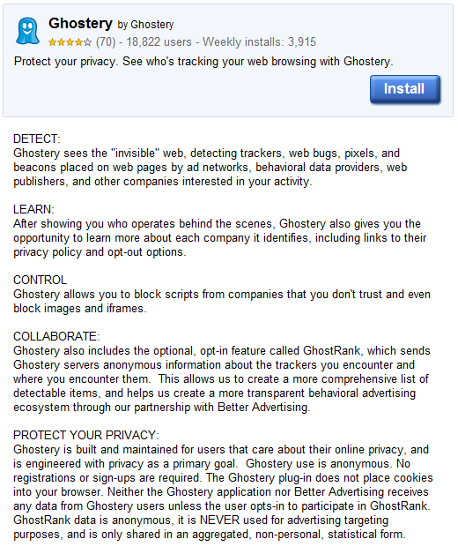
similar to InPrivate Filtering (IE8), but available on other browsers
Moral: security manifests rendered useless by permissively over-privileged extensions

Slide 26
Contributions
Study of Chrome extensions
Large-scale study of >1,000 Chrome extensions
Analyze their manifests for security privileges
Conclude that many or most are over-privileged
Datalog-based policies
Policy language based on Datalog for specifying fine-grained authorization and data flow policies
Visualization tools to “apply” authorization policies to web pages
Semantics of policies and extensions
Formalize the semantics of security policies and extensions in an execution model with arbitrary interleavings
Security property, (L;P)-safety, suitable for use with extensions that interact with other, untrusted code
Extensions implemented
Programming 17 extensions in Fine covering a range of fine-grained authorization and information flow properties for each, and automatically verifying for policy compliance
These include several widely-used Chrome extensions, showing that our model brings benefits to legacy extension architectures
Retargeting to multiple browsers
Extend Fine compiler with a code generator that emits JavaScript (in addition to .NET bytecode)
Extension development in a platform-independent way, allowing for deployment in IE 8, Chrome, Firefox, and C3
Notes:
RePriv: a framework for protecting privacy by returning control of personal information to the client, making dissemination explicit to the user.
Core Behavior Mining: we show how a general-purpose interest profile for a user can be constructed efficiently from within the browser.
Miners: we made RePriv extensible by allowing third-party code to exist within the browser, using and contributing to the personal data maintained by RePriv. RePriv maintains privacy by rigorously verifying the behavior of all third-party code it runs.
Evaluation: we evaluated key aspects of RePriv using data collected from IE8 & Bing toolbar, as well as user studies on mechanical turk.

Slide 27
Our Goals
ext.f9
policy.f9
Explicit and expressive policy language
Automatic verification
Retargeting for multiple browsers
Fine compiler
JavaScript
.NET
JavaScript

Slide 28
Contrast
ext.f9
policy.f9
Curating process
Arbitrary
Too permissive
Time-consuming
Difficult to port
Code in C/C++ or JavaScript is difficult to check
FF overlays
Fine compiler
COM-based extensions
Chrome JS + manifest
JavaScript
.NET
JavaScript

Slide 29
Example: FaceBook Extension
SECURE
^

Slide 30
https://api.del.icio.us/v1/posts/add?
url=http://people.csail.mit.edu/jeanyang&
description=Jean+Yang

Slide 31
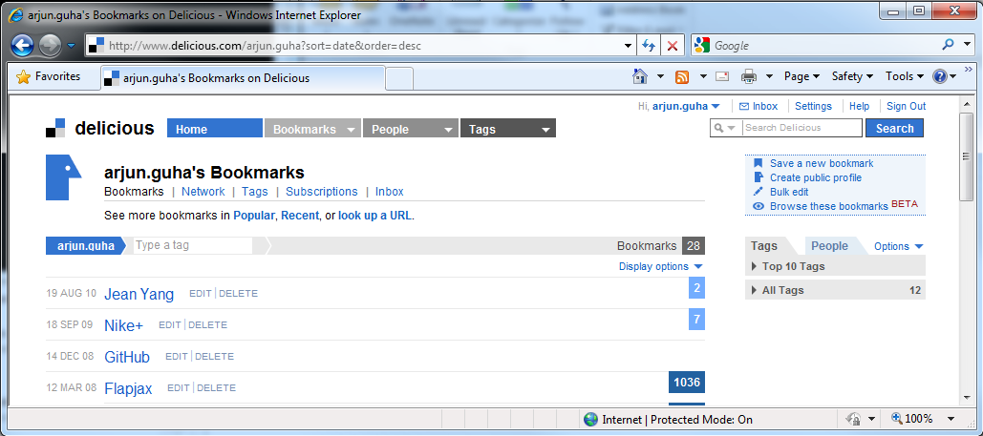
https://api.del.icio.us/v1/posts/add?
url=http://people.csail.mit.edu/jeanyang&
description=Jean+Yang

Slide 32
getName and getWebsites do not exist. ..
:-(
let name = document.getName() in
let website = document.getWebsites()[0] in
...

Slide 33
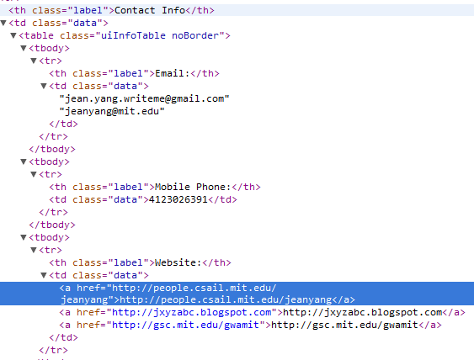
How Do We Pattern-match?
lbls = document.getElementsByClassName("label")
> [ <th class="label">Email:</th>;
<th class="label">Address:</th>;
<th class="label">Website:</th>;
... ]
websiteLbl = (filter isWebsite lbls)[0]
> <th class="label">Website:</th>
websiteLbl.nextSibling
> <td class="data"><a href="... mit.edu ..."> ...

Slide 34
What is the Right Policy?
CanRead <a> tags
Read links to likes, dislikes, groups, posts, friends, etc.
CanRead <td class="data">
Can read phone, email
CanRead <td class="data"> tags, which have a sibling
<td class="label">Website:</td>

Slide 35
Extension Name
Extension Behavior
PrintNewYorker
Appends “?printable=true” to internal
links
on newyorker.com
Google Reader client
Sends RSS
feed links to Google Reader
Gmail checker
Rewrites “mailto:” links to open
Gmail’s
compose page
Bookmarking
Sends selected text to delicious.com
Dictionary lookup
Queries online
dictionary with selection;
displays definition in a floating <div>
Facebook data
miner
Sends
friends’ web
-
addresses to
delicious.com
JavaScript toolbox
Edits selected text
Password manager
Stores
and retrieves passwords on each page
Magnify
under
mouse
Modifies CSS
on the page
Short
URL expander
Sends URLs
to longurlplease.com
Typography
Modifies values
of <input> elements

Slide 36
Policies in Fine
USING REFINED TYPES
^

Slide 37
type elt
val getAttr :
elt
-> string
-> string
Native DOM elements, abstract to Fine
Defined in F#/JavaScript with this type

Slide 38
assume ∀ (e:elt) . EltTagName e "a"
⇒ CanReadAttr e "href"
type elt
val getAttr :
e:elt
-> { key:string | CanReadAttr e key }
-> string
val getTagName :
elt
-> string
Precondition

Slide 39
assume ∀ (e:elt) . EltTagName e "a"
⇒ CanReadAttr e "href"
type elt
val getAttr :
e:elt
-> { key:string | CanReadAttr e key }
-> string
val getTagName :
e:elt
-> { name:string | EltTagName e name }
Postcondition

Slide 40
assume ∀ (e:elt) . EltTagName e "a"
⇒ CanReadAttr e "href"
type elt
val getAttr :
e:elt
-> { key:string | CanReadAttr e key }
-> string
val getTagName :
e:elt
-> { name:string | EltTagName e name }
// code
let getLink elt =
if getTagName elt = "a" then
// true ⇒ EltTagName elt "a"
getAttr elt "href" // requires CanReadAttr elt "href"
else
"not a link"
No runtime overhead (fast)
No runtime security exceptions (robust)
Fine + Z3 check pre- and post-conditions
Postcondition

Slide 41
assume ∀ (e:elt) . CanReadAttr e "class"
assume ∀ (label:elt), (labelText:elt) .
EltParent labelText label
&& EltAttr label "class" "label"
⇒ CanReadValue labelText
assume ∀ (data:elt), (label:elt), (labelText:elt),
(website:elt), (parent:elt) .
EltParent data parent
&& EltParent label parent
&& EltParent website data
&& EltParent labelText label
&& EltAttr label "class" "label"
&& EltTextValue labelText "Website:“
⇒ CanReadAttr website "href"
Can read all "class" attributes
Can read all data labels
data and label are siblings via parent

Slide 42
(L;P)-safety: Semantics of policies
Execution of browser extensions interleaved with JS-code on a web page
Key feature of (L;P)-safety: Security of an extension is independent of effects of JS on the page
Security of browser does not depend on the page currently being viewed
Simply programming model: extension author does not have to consider JS interleavings in order to comply with security policy

Slide 43
Safety by typing
Main theorem:
Given a Datalog policy P, a set of ground facts L, an environment Γ such that Γ |= L, a program e and a type t.
P; Γ |- e : t => e is (L;P)-safe
Reduction relation: P |- (L;e) → (L’;e’)
Reduction steps are guarded by policy queries evaluated over a set of accumulated ground facts L
Theorem says: well-typed programs never raise security exceptions

Slide 44
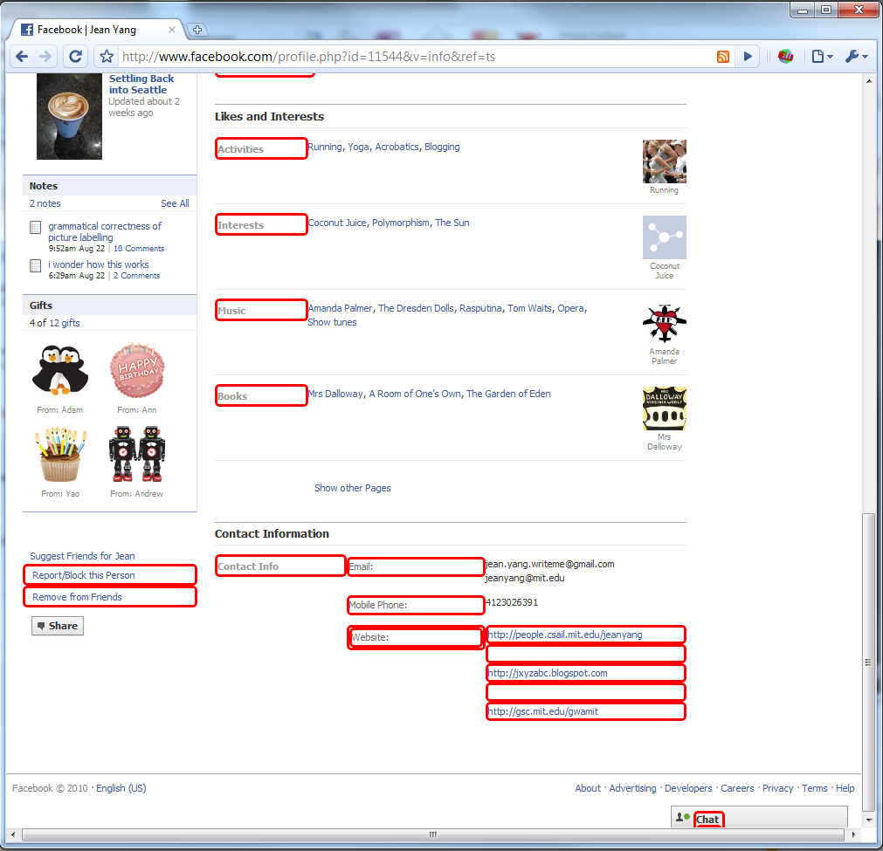
Visualizing Policies

Slide 45
Experimental Summary
Variety of extension types
Over 1,500 LOC total
Many extensions ported from Chrome
Only the content script in Fine
Compiled to JavaScript using a new Fine backend
Much of the code remains in the extension core

Slide 46
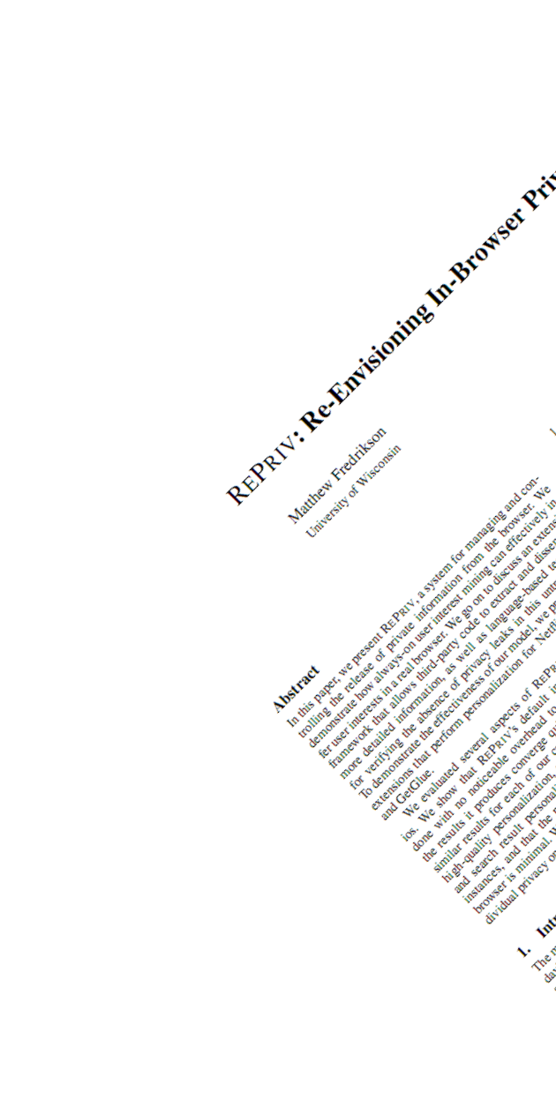
Ben Livshits
Microsoft Research
Redmond, Washington
…with help from Matt Fredrikson, Arjun Guha, Nikhil Swamy, and others
http://research.microsoft.com/~livshits/

